Slide 1
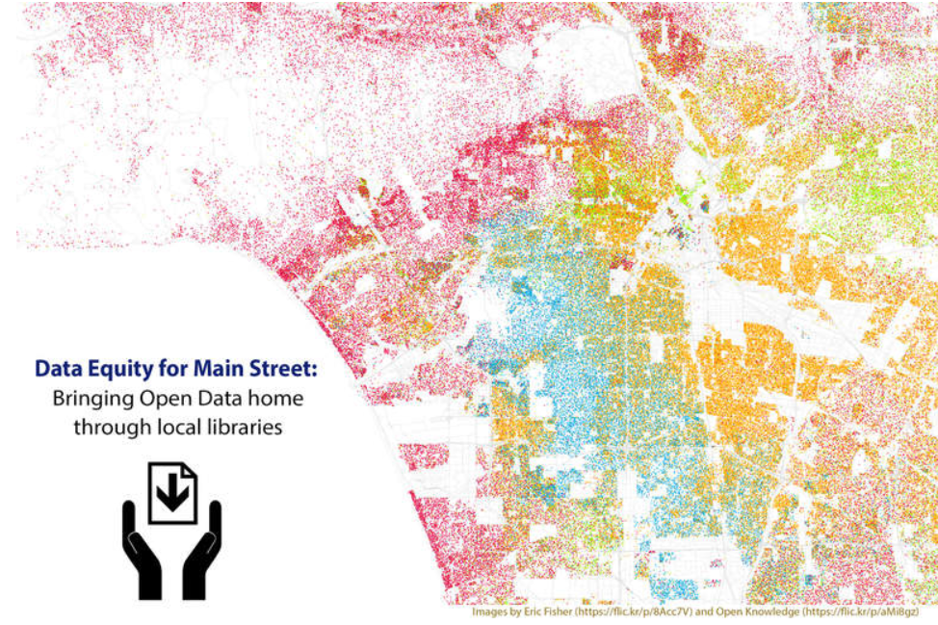
Unlocking the Power of Open Data
Class 2

Slide 2
Review from Session 1
Understand and define “open data.”
Explain where open data can be found and show others how to find it
Names some common types of open data
Identify if data has any limitations on use
Notes:
Class 2a: Welcome and Review of Class 1
Estimated Time: 10 minutes
Learning Objective: Demonstrate familiarity with topics from Class 1
Discussion: Review key points from Class 1. Ask questions of the class. If they are unable to answer any of the questions, provide the answers.
Who can tell me what open data is?
What’s the difference between closed and open data?
Where are some places I might find open data?
What kind of questions can open data answer?
What is metadata?
In this class we’ll gain a deeper understanding of metadata and how it impacts the quality of data you find. You’ll also take a take a treasure hunt, discovering where to find data to answer questions.
Activities:
Ask the class if anyone did any searches for open data after Class 1. Have them share their findings.
Ask the class if anyone thought more about a question they’d like to answer with open data. Have them share.

Slide 3
Objectives for Session 2
Find data quality information for different datasets
Use open data in a variety of formats to answer specific questions.
Notes:
Class 2: Objectives
In this class we’ll gain a deeper understanding of metadata and how it impacts the quality of data you find. We’ll create visualizations and compare multiple datasets to tell a story.

Slide 4
The Details Behind the Data
What is Metadata?
Data (or information) that describes the data
Why is it important? QUALITY…
For the same reason that you…
look at the date on a news article
trust some websites more than others
read the instructions before putting together a piece of furniture
Notes:
Class 2b: The details behind the data
Estimated Time: 30 minutes
Learning Objective: Find data quality information in the metadata or elsewhere (e.g., how it was collected, who collected it, level of geography, sample size, release date, known limitations)
Discussion: During the opening few minutes of the class, participants have reviewed the definition of open data and the key points from the first class. Remind participants that during the first class, they looked at a few datasets and discussed whether they were open or not. To do that, they already used metadata. Licenses are one part of a dataset’s metadata. More broadly, metadata is data that describes the data. It is a summary of basic information that describes various data attributes. It helps a user decide whether they trust the data and whether it can answer their question.
When research organizations, journalists, governments, nonprofits and private companies publish data for public use, many provide metadata so that others can use the data more easily and effectively.

Slide 5
Who, What, When, Where, Why (and How)
The 5 Ws
Who PUBLISHED it?
Who/What is the SOURCE?
What TYPE of data? (text, numbers, images, etc.)
What FORMAT of data? (TXT, XLS, SHP, CSV, etc.)
What is it? DESCRIPTION
When were the data published? DATE
Where/When are the data from? COVERAGE
How can I use it? LICENSE
Why publish? DESCRIPTION (not usually included)
Notes:
CLASS 2b (cont’d)
While organizations publishing data might describe their metadata differently, and often use some jargon, an easy way to remember is to go back to the 5Ws (Who, What, Where, When, Why and How).
WHO is the Publisher? - the individual or team responsible for a data resource.
WHO/WHAT is the Source? - where the data comes from, e.g. government database, etc.
WHAT Type of data? - the nature of the resource, for example, type(s) of data, including text, numbers, photo images, spatial location, etc.
WHAT Format of data? - the type of file or media format, e.g. SHP, PDF, TXT.
WHAT is it? Description - a text description of the data source, using keywords that are descriptive and show up in search results.
WHEN were the data published? Date - the date the data was created.
WHERE/WHEN are the data from? Coverage - what the data covers. For instance, the geographic region or jurisdiction, or the time period during which the data was collected.
How can I use it? LICENSE (as discussed in the first class)
WHY publish? DESCRIPTION (IF this is included, which is often not the case)

Slide 6
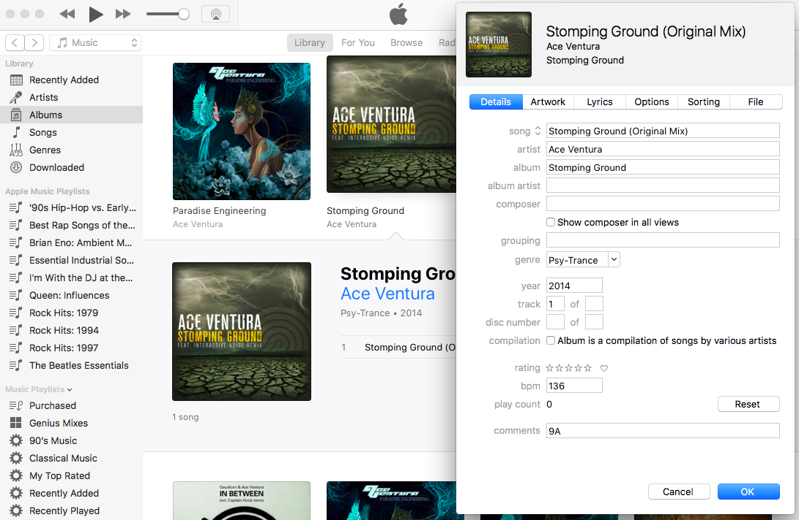
Metadata You Know and Love
iTunes Album and Song Information
Notes:
While you might not have known what it was called, you already use and are familiar with metadata. It’s not as scary as it sounds. One of the most common ways we interact with metadata is through things like iTunes song information.
These data are stored in various ways. The data in this class will be available on an organization’s website or data portal.

Slide 7
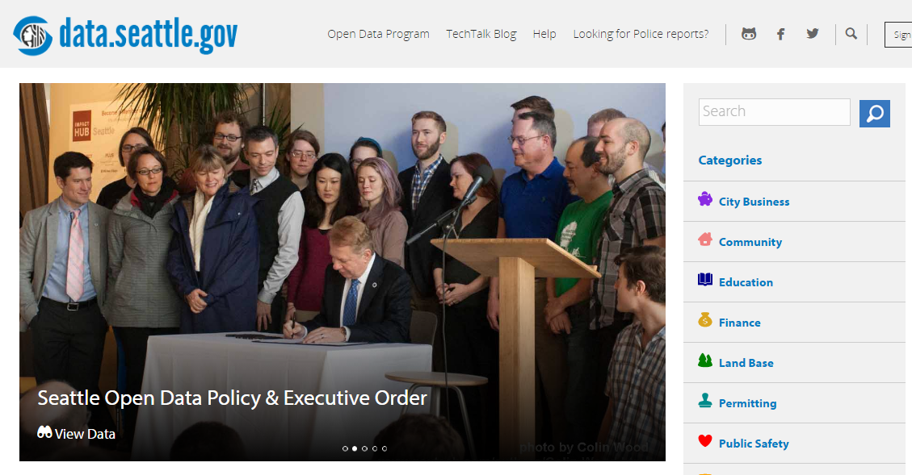
Notes:
Class 2b: The details behind the data #1a
Seattle Open Data a. Show slide with intro page: https://data.seattle.gov/

Slide 8
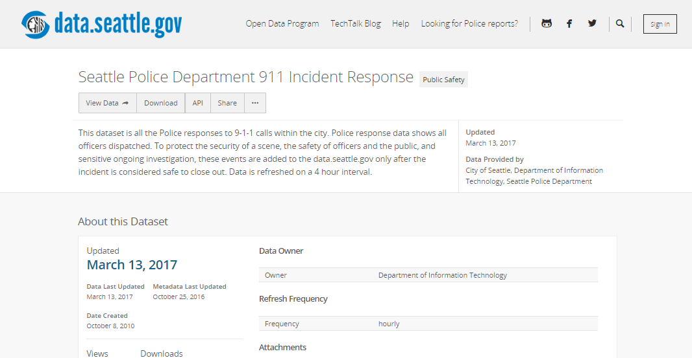
Title
text
Notes:
Class 2b (cont’d) : The details behind the data #1b
Activities: Now we’re going to look at some open data see what the metadata can tell us:
b. Go to Police Department 911 Incident Response data
https://data.seattle.gov/browse?category=Public+Safety
To navigate from the home page:
Click on Public Safety
Click on Police Department 911 Incident Response
Try to answer the following questions:
i. Who published the data?
ii. When was it last updated?
iii. What kind of license does it have? Are there limitations on what you can do with it?
iv. How often is it updated?
v. What kind of questions can this data answer?
vi. What kind of questions can’t it answer?

Slide 9
Insert local example if you have one
Add text here
Notes:
Class 2b: The details behind the data #2
Have participants run through your local, state or county open data portal. They should find a set of data and then answer the questions:
Who published the data?
When was it last updated?
What kind of license does it have? Are there limitations on what you can do with it?
How often is it updated?
What kind of questions can this data answer?
What kind of questions can’t it answer?

Slide 10
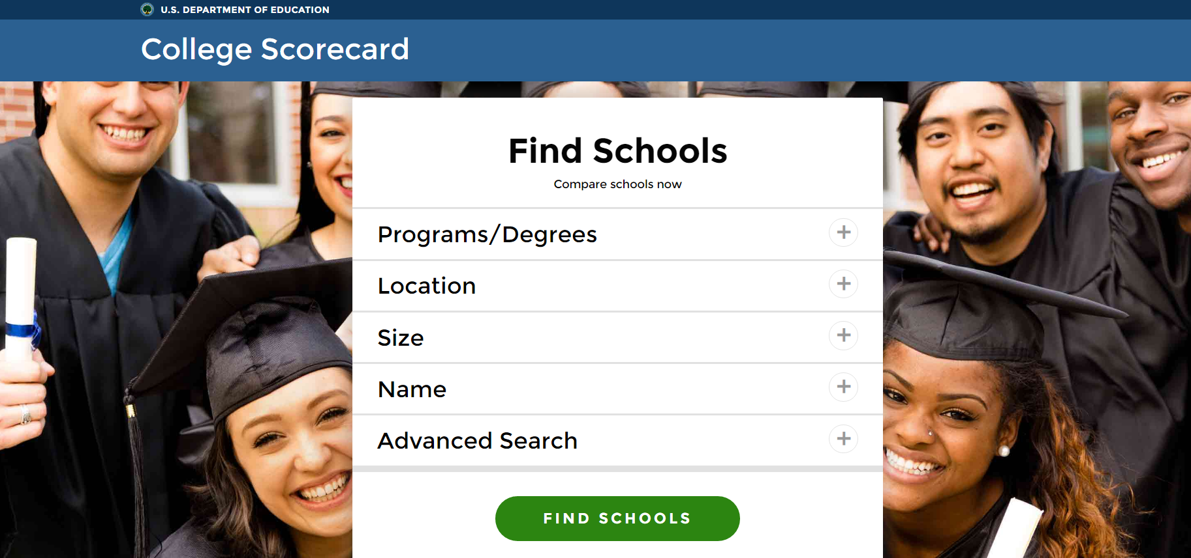
https://collegescorecard.ed.gov/
Notes:
Class 2b: The details behind the data #3
College Scorecard: Navigate to the data (see next slides)

Slide 11
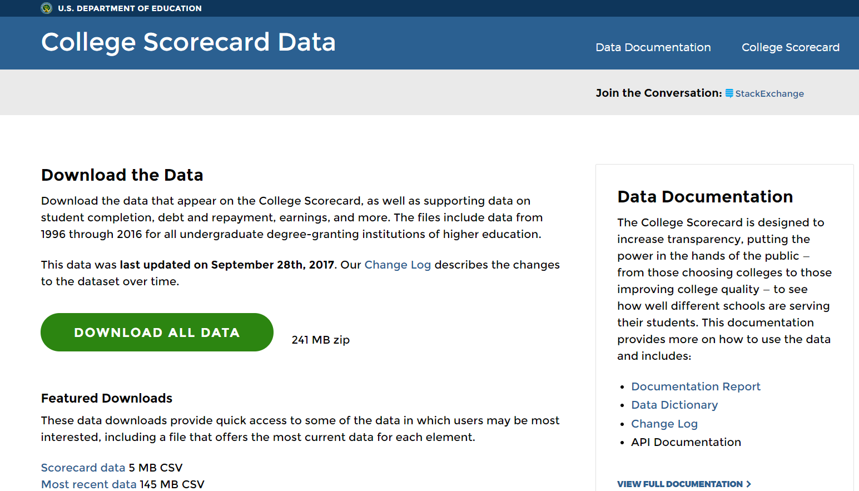
Notes:
Class 2b (cont’d)
College Scorecard
We looked at this site for a few minutes in the first class. Let’s take a quick look here and find the metadata.
Show slide with intro page of: https://collegescorecard.ed.gov/data/
Have participants go to the College Scorecard Data page on their computers https://collegescorecard.ed.gov/data/.
Explain:
This is a large dataset that received a lot of interest when it was published. This looks a little different from the Seattle data. Here’s why:
The publisher (the US Dept of Education) knew that this would be a controversial dataset and that many people would use it. They would want to know about limitations, methodology etc. Given this, US DOE wants to be clear about what you - as a user - can and cannot expect to find in the data.
When the USDOE released this data, they also released analysis. They want to ensure that the numbers behind the analysis are transparent, which will increase the likelihood that people will trust the data.

Slide 12
Notes:
Class 2b (cont’d)
Ask participants where they think the metadata is located. Hint to the documentation text if no one sees it.

Slide 13
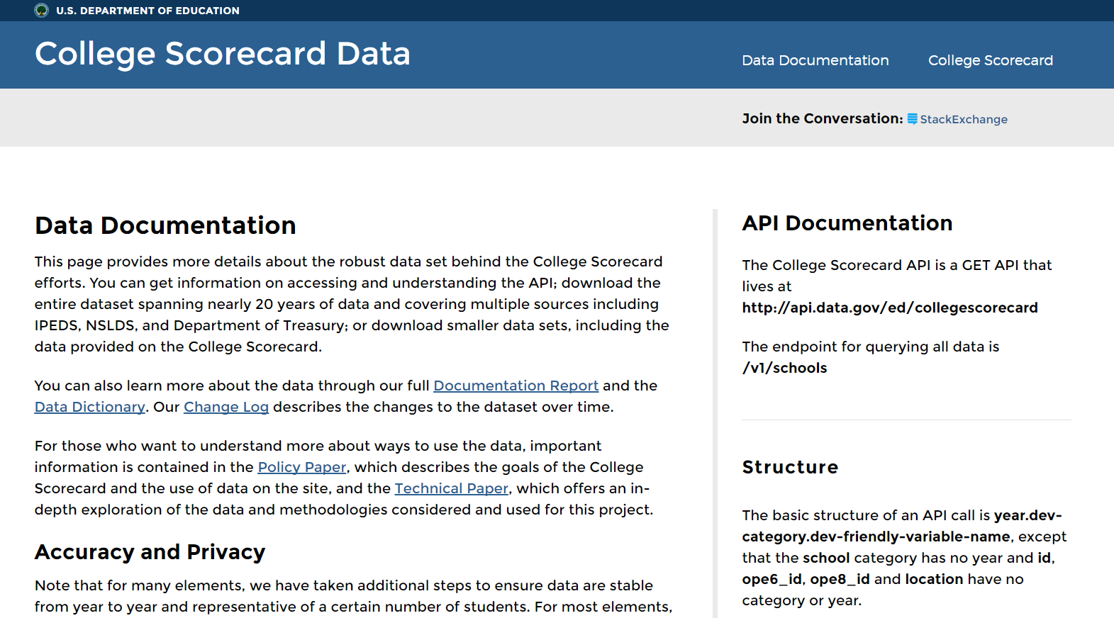
Notes:
CLASS 2B (cont’d)
Open slide with data documentation page (https://collegescorecard.ed.gov/data/documentation/) and ask participants to spend a few minutes looking through the web page and see if they can answer the following:
How many years does the dataset cover? (Answer: 20)
What are some of the categories of data? (Answer: Root, School, Academics, Admission, Student, Cost, Aid, Repayment, Completion, Earnings)
When was the latest update to the data made (Answer: Look at the “Change Log” (https://collegescorecard.ed.gov/data/changelog/)
What kind of questions can this data answer? Examples: -What is the average annual cost of attending a particular college/university?
-What are the average SAT test scores for students who are admitted?
-What is the average amount of student debt for students at this institution?
-How much do students typically earn after graduation?
What kind of questions can’t it answer? Examples: -Who are the notable faculty members at a particular university? -What is the level of student satisfaction with campus climate? -How many years does it take for most students to earn a bachelor’s degree?

Slide 14



Treasure Hunt: Answer Questions with Data
Notes:
Class 2c: Treasure Hunt: Answer Questions Using Data
Estimated Time: 30 minutes
Learning Objective: Use open data in a variety of formats to answer specific questions.
Discussion: see activity below
Activities:
The main goal is exploration! Using one of the Treasure Hunt Handouts (Fun, Business, or Environment or Agriculture)
take about 20 minutes and try using open data to answer the questions The links provided will lead to data which will answer the questions. If some participants want to answer their own questions on these sites, they are welcome to do so.
Alternate Activities:
If none of the above look interesting, or you want to explore new territory, feel free to look for your own dataset and poke around, as an alternative to using the ideas above!
Here are some lists of datasets:
Data.gov Datasets
Awesome Public Datasets
Free Public Data Sets for Your First Project
Carnegie Mellon Datasets
Calvin College Datasets
Be aware of the following issues when choosing datasets to analyze in a 20 minute time span, on public computers:
Excel capabilities: Excel has some calculating capabilities, but it is not a full statistical package, so it can’t get very complex
Download speeds: Some of these datasets are extremely large, and can take a long time to download
Permission to download data: Some datasets are available freely outside the US, but not inside. Additionally, some libraries do not generally allow people to download files.
Complexity of dataset and data: If you aren’t sure how the data were collected and what they mean, it’s worth taking more time to study them, after this class.
Persistence of links: While we continuously update this curriculum, you may find that some of these data sets are no longer available.
File Type/Size: It may not work in this setting to try using data that comes as a zipped file, or even a large file
Data Cleaning: Sometimes you will find that data is separate from labels for each column. It’s probably best to work on this kind of data when you have more time.

Slide 15
Next Time…
Learn about different ways to present your information (and some common pitfalls!)
Hands-on: Use open data to create charts, graphs and maps.
Notes:
Quick note of what we’ll do next time.

Slide 16
Can you do this?
Find data quality information for different datasets
Use open data in a variety of formats to answer specific questions.
Notes:
Class 2 End of session
Before we finish, we’d like everyone to fill out an evaluation. This will take no more than 5 minutes. Let the class know:
this class is a pilot and we want to know whether the class met your expectations and how we can improve.
We’d like you to answer a few questions to see if the class is the curriculum was able to communicate information well enough.

Slide 17
Thank
You

